Slide 1
Schematic Capture with gSchem
Presented by Ed Venator
September 20, 2012
Case Western Reserve University
IEEE Sparktalks

Slide 2
Agenda
Why use schematic capture software?
About gSchem
A brief introduction to Linux for EEs
The basics of drawing schematics
Creating your own part symbols
Resources for learning more and using gEDA

Slide 3
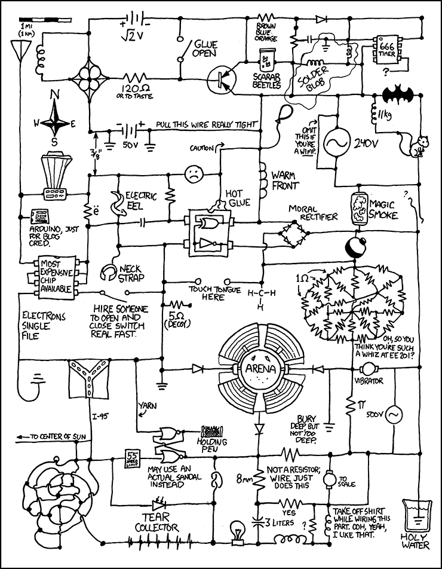
Hand-drawn Schematics

Slide 4
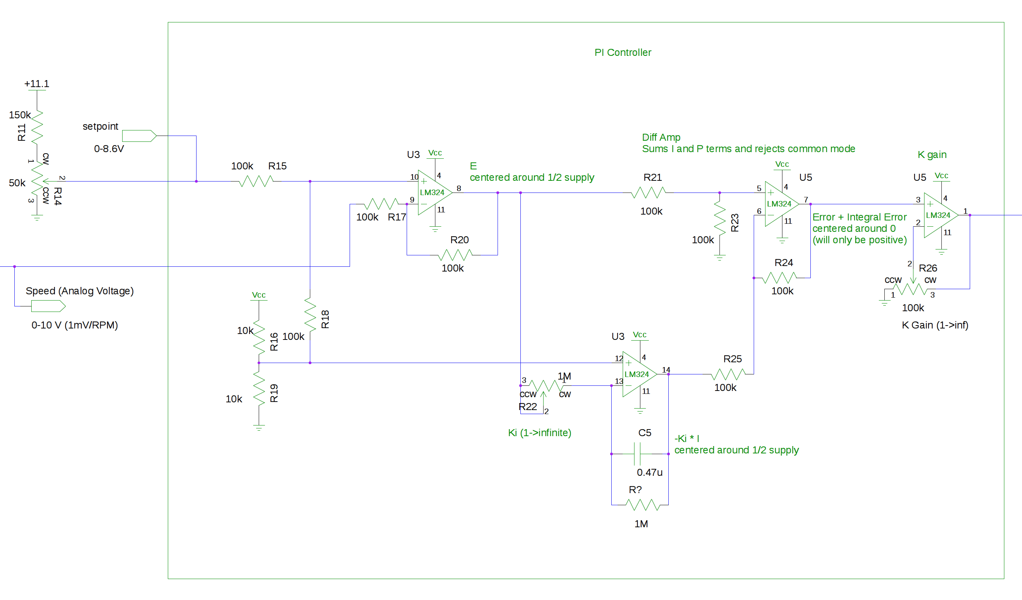
Schematic Capture Software

Slide 5
gSchem
Part of the gEDA suite (gSchem, PCB, gerbv)
Free, Open Source
Runs on Linux, Unix, Mac*, Windows**
Included in CWRUbuntu-EE
Install in Ubuntu from the software center (search for geda)
* There may be some installation difficulties. If curious, ask Chris Dickey
** Under CYGWIN, and it's kind of buggy

Slide 6
Resources
gEDA home website:
http://www.geda-project.org/
gSchem symbols and PCB footprints:
http://www.gedasymbols.org/
Rules for making symbols:
http://wiki.geda-project.org/geda:gschem_symbol_creation
List of standard footprints:
http://wiki.geda-project.org/geda:pcb_footprint_naming_conventions

